Slide 1

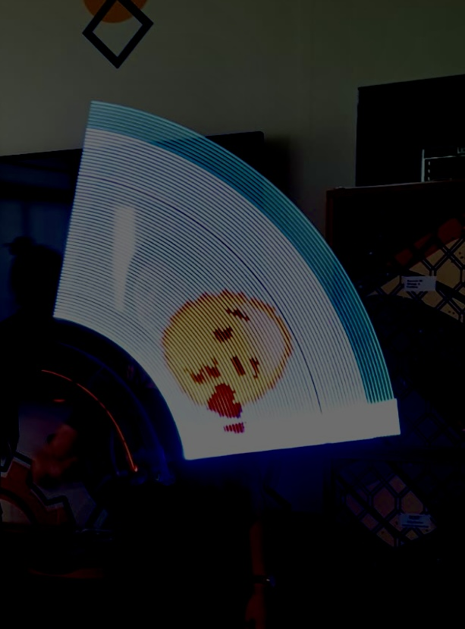
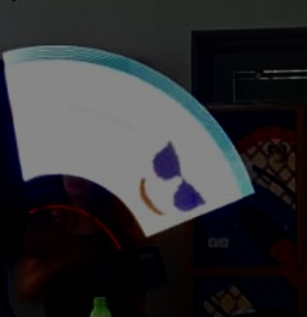
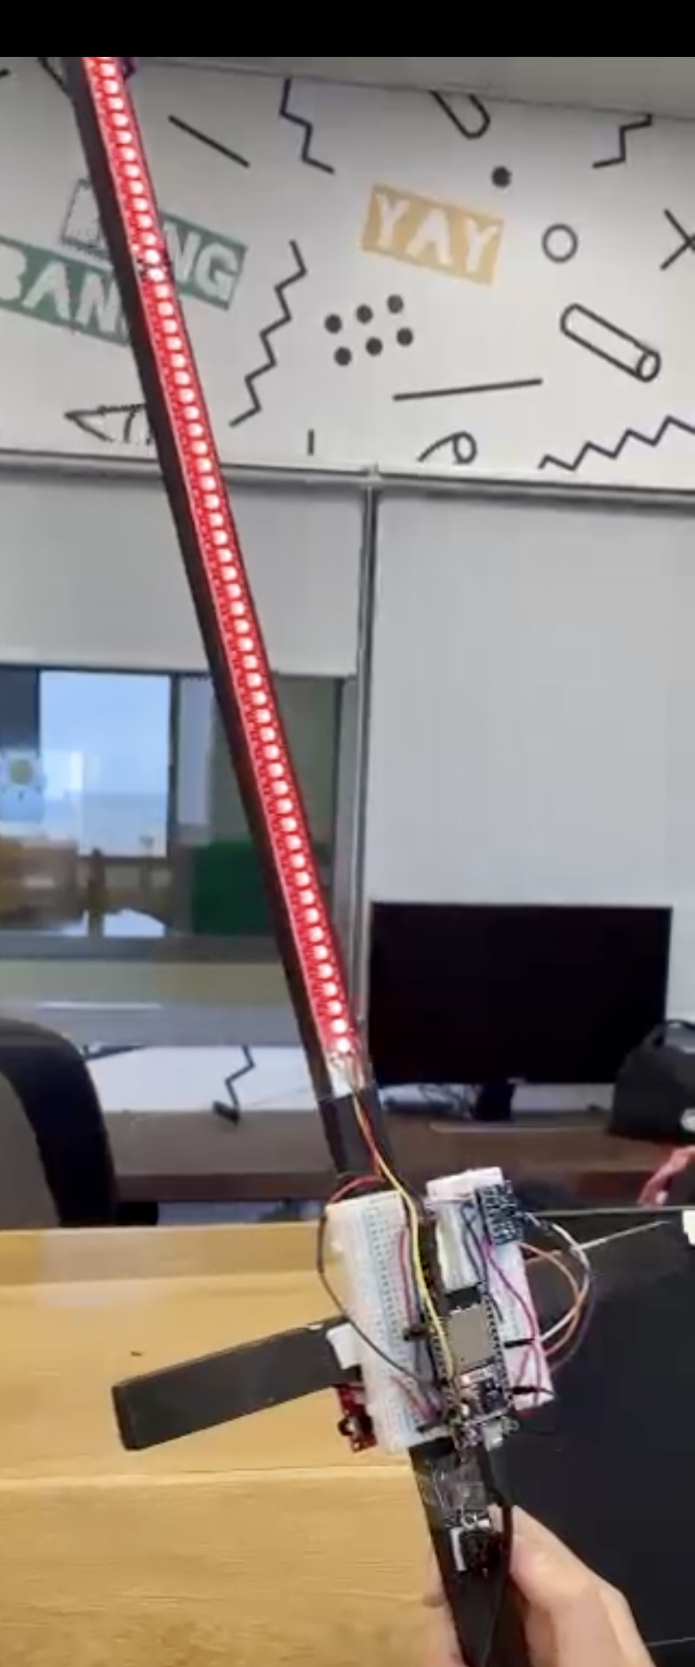
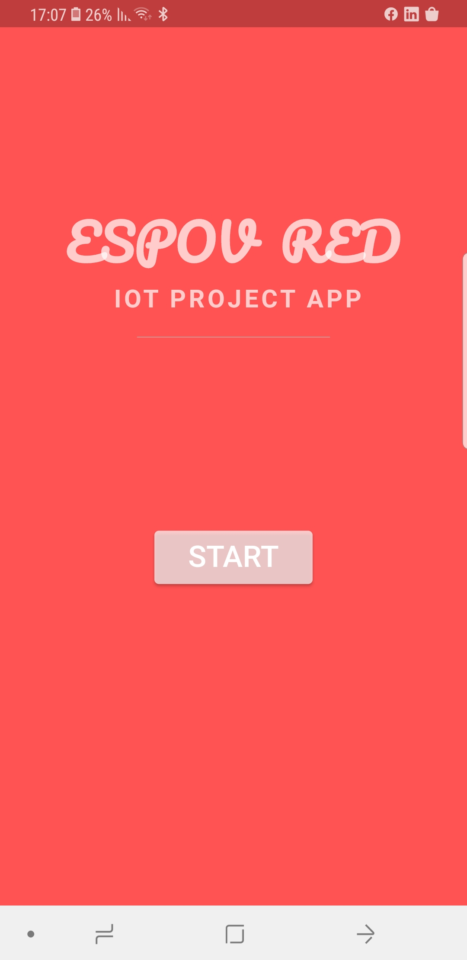
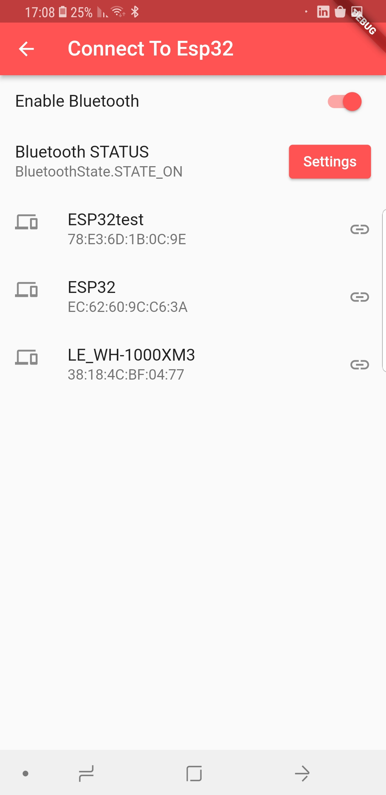

<ESPOV RED>
<A persistence of vision LightSaber>
A lightsaber using the Esp32, LED Strip and a Gyroscope. It displays an image when moved in the air.
Images can be selected using a mobile application and sent over Bluetooth to the esp.
Multiple images can be selected using a web application, stored in the esp32 storage and displayed, images are changed when the button is pressed.
Images are displayed with all possible movements, horizontally, vertically or randomly at all speeds.
The images displayed in the air:
The hardware:
The application in steps:
Adan Assle, Manar Saadi, Hadeel Arsheed
Instructor: Tom Sofer

